Slide 1
Warm Up - Conceptual Questions
What does it mean for an object to be mutable?
What is a pointer and how can we manipulate pointers to point to different objects?
What is the difference between a deep copy and a shallow copy?
What are the default mutation functions for lists in python?

Slide 2
General Definitions - Mutable
For default python objects, such as lists, being mutable means we can change the values held by said object after creation
Lists are mutable, strings and tuples are not
Also important for dictionaries
Dictionaries are mutable
Keys for dictionaries must be immutable

Slide 3
Python Lists - Quick Rundown of Functions
lst[0] = 1
Directly changes index 0 of lst to 1
lst.append(1)
adds 1 to the end of the lst
lst.append([1])
adds nested list [1] to the end of the list
lst.extend([1, 2, 3])
appends each element of the argument (1, 2, and 3).
lst.insert(2, 5)
inserts 5 into index 2 of lst (doesn’t replace)
lst.remove(5)
removes the first occurrence of 5 from lst
lst.pop()/lst.pop(i)
removes & returns the last item of lst/removes & returns the item at index i

Slide 4
General Definitions - Pointers
Pointer is an address for an object
Instead of actually storing a list inside another list, the outer list just stores the address of the inner list
When you access the pointer of an object, you automatically go to said address and then interact with the object
lst = [1, 2, 3]
lst doesn’t actually store [1, 2, 3] but instead stores a pointer
This is why if we assign another value to lst, [1, 2, 3] is not immediately destroyed

Slide 5
Pointers/Mutation
lst = [1, 2, 3]
lst2 = lst
lst = 1
lst2[0]
>>> 1
lst doesn’t actually store [1, 2, 3] but instead stores a pointer
This is why if we assign another value to lst, [1, 2, 3] is not immediately destroyed
How can we abstractly represent pointers and lists?

Slide 6
Python Lists - Box and Pointer Overview
Bookkeeping system similar to environment diagrams
Box - container for a value or a pointer.
Lists are usually multiple boxes in a row while linked lists are represented by pairs of boxes
Pointer - arrow that represents a pointer.
Held by just a variable: lst
Held by a box: nested list

Slide 7
Box and Pointer - General Approach
Treat these questions like environment diagrams
Be methodical and try to keep track exactly where you are in execution at all times
Remember when to create a new list and when you just have to move a pointer
Create “snapshots” at certain execution points so if you make a mistake it’s easier to revert to a previous step
A good time to use scratch paper
Since you will be modifying a lot of pointers and lists, it may be helpful to do work on another page

Slide 8
List Slicing
list[i:j:k]
i - starting index; inclusive
j - ending index; exclusive
k - step size
i, j, k can all be negative
last element of list has index -1
list slicing doesn't error - if the slice doesn't make sense, it returns the empty list
common uses: list[:] , list[::-1]
shallow copy of entire list, reverses the list

Slide 9
Last Notes
lst=lst_1 + lst_2 - creates a new list of the elements of lst_2 tagged onto the elements of lst_1.
shallow copy - only copies pointers, doesn’t replicate inner lists
lst = lst + [1] - creates a new list with [1] tacked on
lst += [1] - mutates the original lst (same as lst.extend([1])

Slide 10
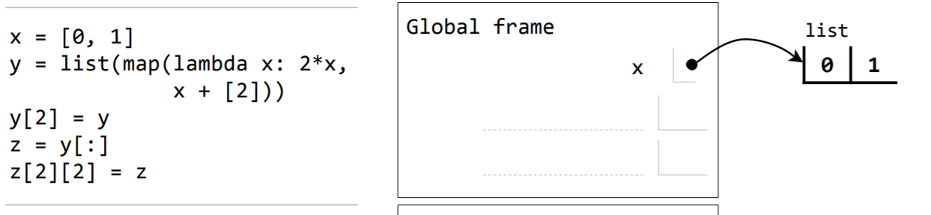
Problem 1: Spring 2013

Slide 11
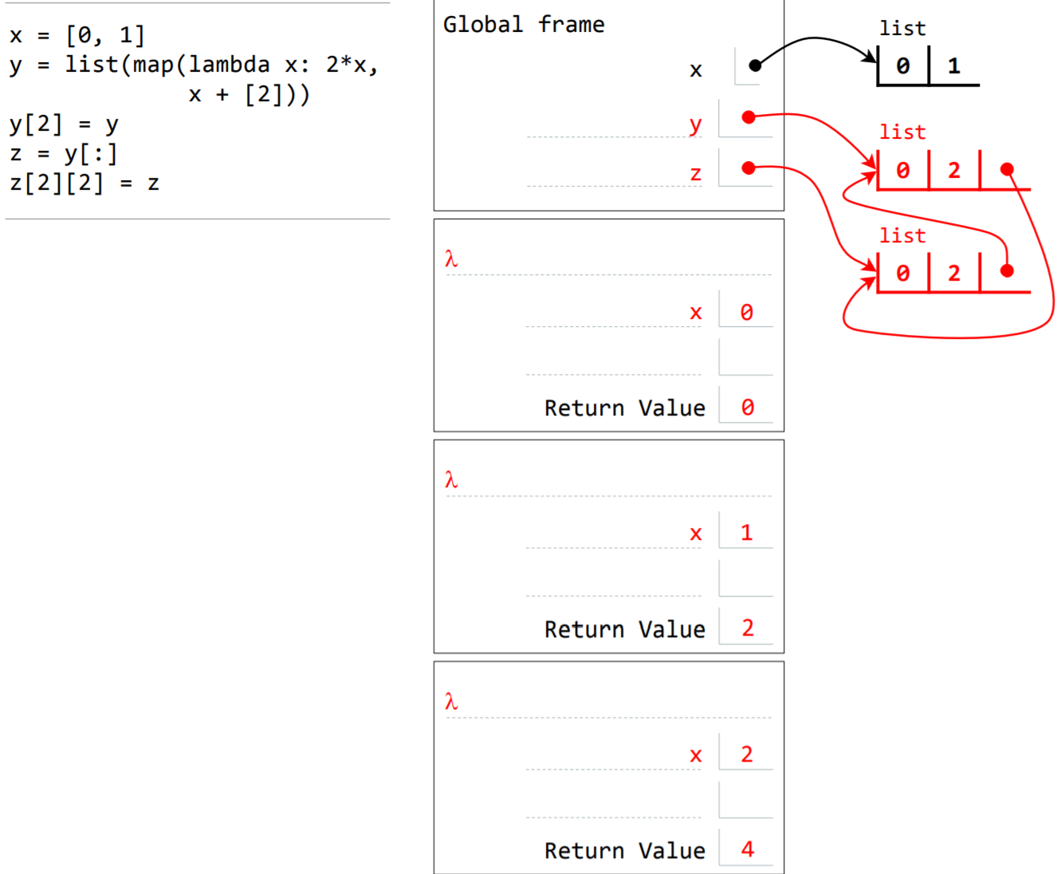

Slide 12
def add_lists(list1, list2):
"""
>>> add_lists([1, 2, 3], [4, 5, 6])
[5, 7, 9]
"""
return _______________________________
def hamming_distance(list1, list2):
"""Hamming distances are a useful metric in the field
of information theory and digital signal processing.
The hamming distance takes in two lists of the same length that contain only the elements 0 or 1 and returns the number of elements in which these
two lists differ.
Hint: there are many ways to define this function --
try to use add_lists in your implementation
for the cleanest solution.
>>> hamming_distance([1, 0, 0, 1, 1, 1, 0], [1, 1, 1, 0, 1, 1, 1])
4
"""
return sum(______________________________________)

Slide 13
def add_lists(list1, list2):
"""
>>> add_lists([1, 2, 3], [4, 5, 6])
[5, 7, 9]
"""
return [x + y for x,y in zip(list1, list2)]
def hamming_distance(list1, list2):
"""Hamming distances are a useful metric in the field
of information theory and digital signal processing.
The hamming distance takes in two lists of the same length that contain only the elements 0 or 1 and returns the number of elements in which these
two lists differ.
Hint: there are many ways to define this function --
try to use add_lists in your implementation
for the cleanest solution.
>>> hamming_distance([1, 0, 0, 1, 1, 1, 0], [1, 1, 1, 0, 1, 1, 1])
4
"""
return sum([1 for elem in add_lists(list1, list2) if elem == 1])

Slide 14
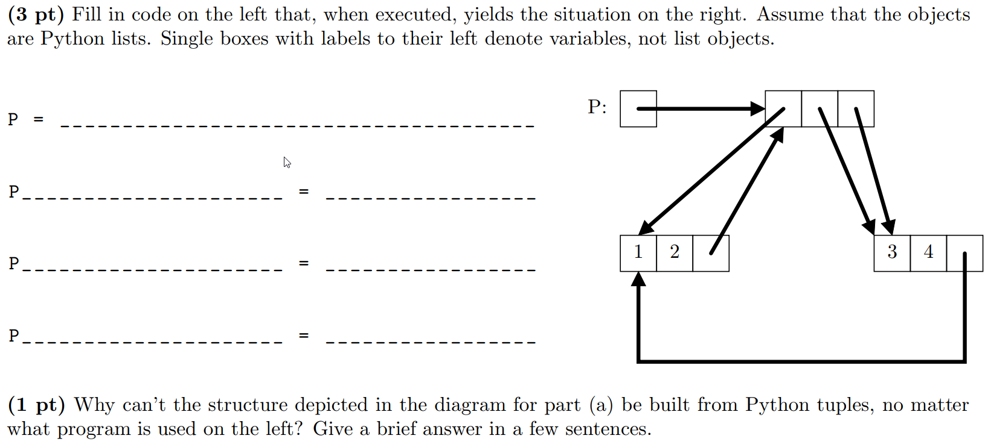
Question 2: (Spring 2016)

Slide 15
Question 1: (Spring 2016) Soln Part 1
P = [[1, 2, None], [3, 4, None], None]
P[0][2] = P
P[1][2] = P[0]
P[2] = P[1]

Slide 16
Question 1: (Spring 2016) Soln Part 1
P = [[1, 2, None], [3, 4, None], None]
P[0][2] = P
P[1][2] = P[0]
P[2] = P[1]
Copies P’s pointer
Copies P[0]’s pointer
Copies P[1]’s pointer

Slide 17
Question 1: (Spring 2016) Soln Part 1
P = [[1, 2, None], [3, 4, None], None]
P[0][2] = P
P[1][2] = P[0]
P[2] = P[1]
Copying a Pointer

Slide 18
Question 1: (Spring 2016) Soln Part 2
P = [[1, 2, None], [3, 4, None], None]
P[0][2] = P
P[1][2] = P[0]
P[2] = P[1]
Why can’t we do this with tuples?

Slide 19
Question 1: (Spring 2016) Soln Part 2
P = [[1, 2, None], [3, 4, None], None]
P[0][2] = P
P[1][2] = P[0]
P[2] = P[1]
Why can’t we do this with tuples?
Since tuples are immutable, anything a tuple has a pointer to must exist before the tuple itself. However, since we have a cycle of pointers, each separate “tuple” must exist before the others. P[0] needs P to exist beforehand which then needs P[0] to exist beforehand, which is impossible.

Slide 20
Python Dictionaries
>>> d = {}
>>> d['hello'] = 'world'
>>>d['hello']
>>>'world'
maps keys to values
important functions
<key> in <dict> - tests if a key exists in the dictionary
list(<dict>.keys()) / list(<dict>.values()) - returns list of keys/values in the dictionary

Slide 21
Question 2 Hints (Fall 2015 Final Q2)
Draw Block and Pointer Diagrams for the following snippet of code:
s = [2, lambda: list(s)]
s.append(s[1]())
s.extend(s[1]())
Hints:
Remember the difference between append and extend - especially with lists
Try to find a way to keep track of what you’ve executed and what’s next to run

Slide 22
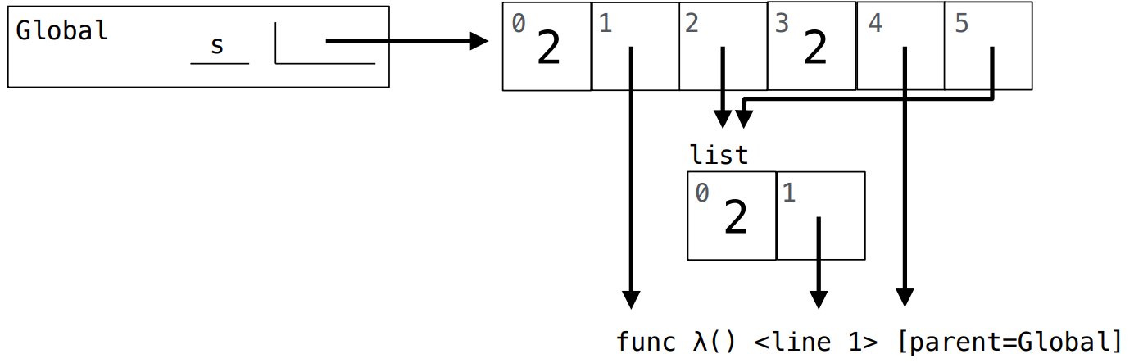
Question 2 Soln. 1st Snippet
s = [2, lambda: list(s)]
s.append(s[1]())
s.extend(s[1]())

Slide 23
Question 2 Hints (Fall 2015 Final Q2)
Draw Block and Pointer Diagrams for the following snippets of code:
Hints:
Remember splicing returns a copy of the elements
Shallow or deep copy?
Drawing the environment diagram may help for the last snippet
What does append return?
s = [2, lambda: s]
s.append([s[1:]])
s.extend([s[1:]])
s = [2, lambda: list(s)]
s.append(lambda: [s.append(s.pop()())]) s.extend(s[2]())

Slide 24
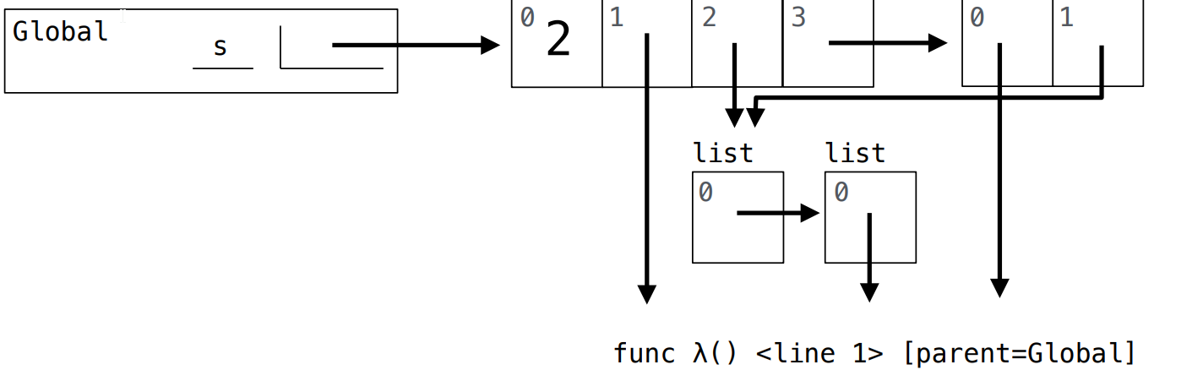
Question 2 Soln. 2nd Snippet
Copy of the extend call
s = [2, lambda: s]
s.append([s[1:]])
s.extend([s[1:]])
Copy of append call

Slide 25
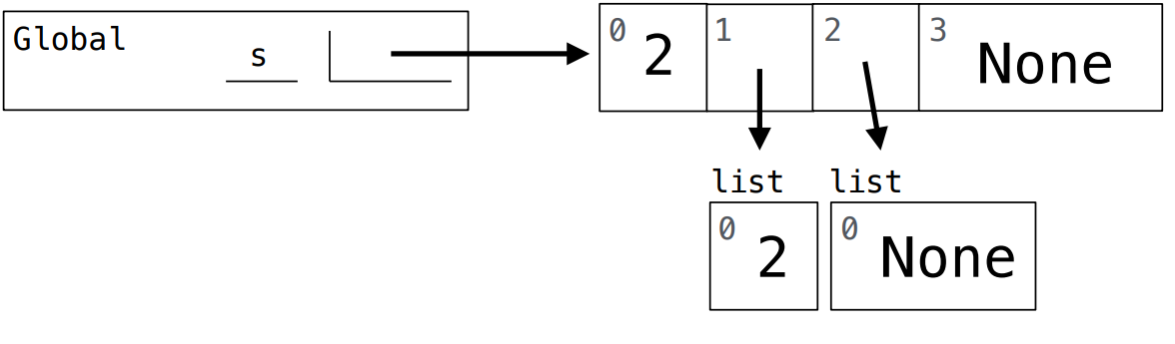
Question 2 Soln. 3rd Snippet
s = [2, lambda: list(s)]
s.append(lambda: [s.append(s.pop()())]) s.extend(s[2]())
Python Tutor Link to Review:
https://goo.gl/JW87oh

Slide 26
Extra Practice:
Spring 2016 Q3
Try questions from the python lists section from the resources section on the 61A website
If you are still a bit shaky on the harder questions, trying to draw an environment diagram for the questions may be helpful

Slide 27
Question 3 - Final exam Spring 2014
Mutable objects - Dictionaries

Slide 28
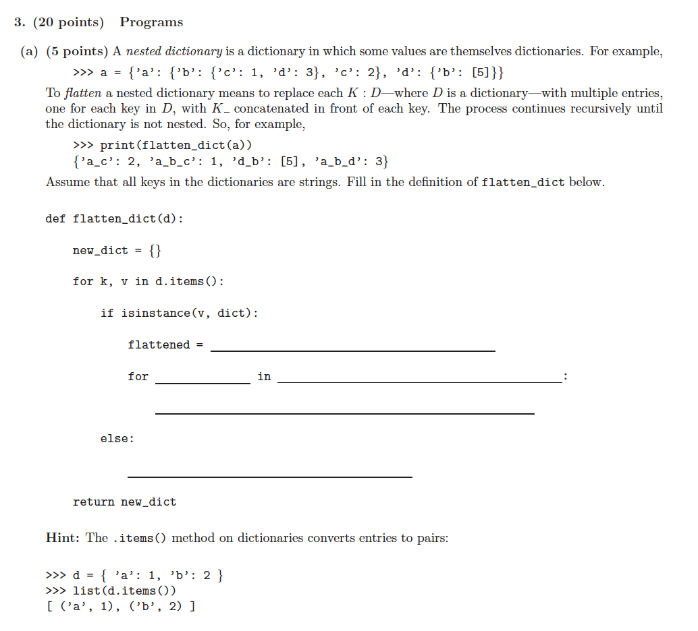

Slide 29
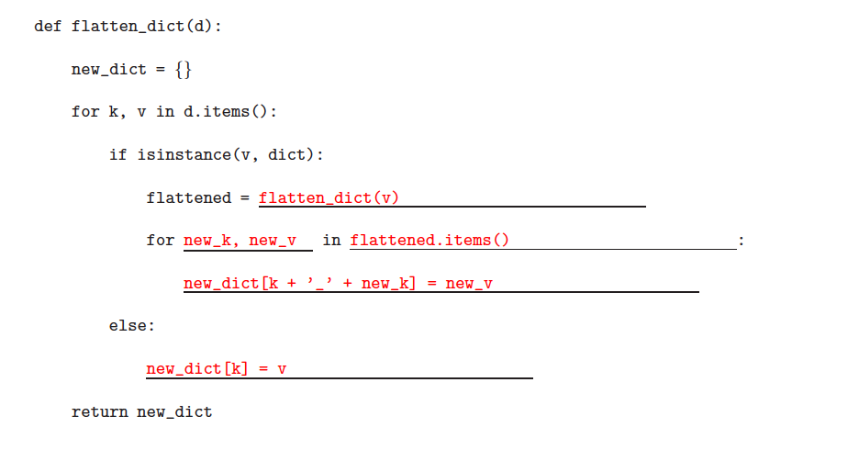
Solutions:

Slide 30
Linked Lists - Box and Pointer Overview
Same idea as with default python lists
boxes are containers, pointers point to objects
Instead of an array of boxes, we only use pairs of boxes to represent a Link
lnk.first, lnk.rest

Slide 31
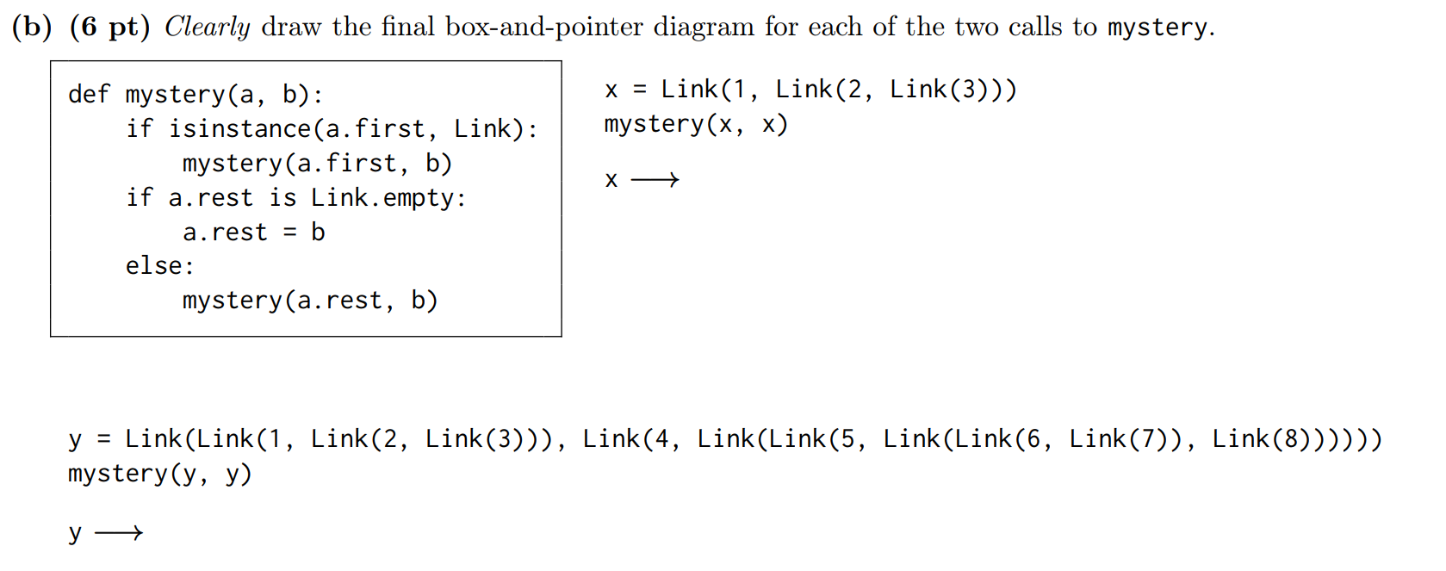
Question 3 (Summer 2017 Final Q2)
Notes:
Hints: First figure out what the function is doing and then apply it to the linked lists.

Slide 32
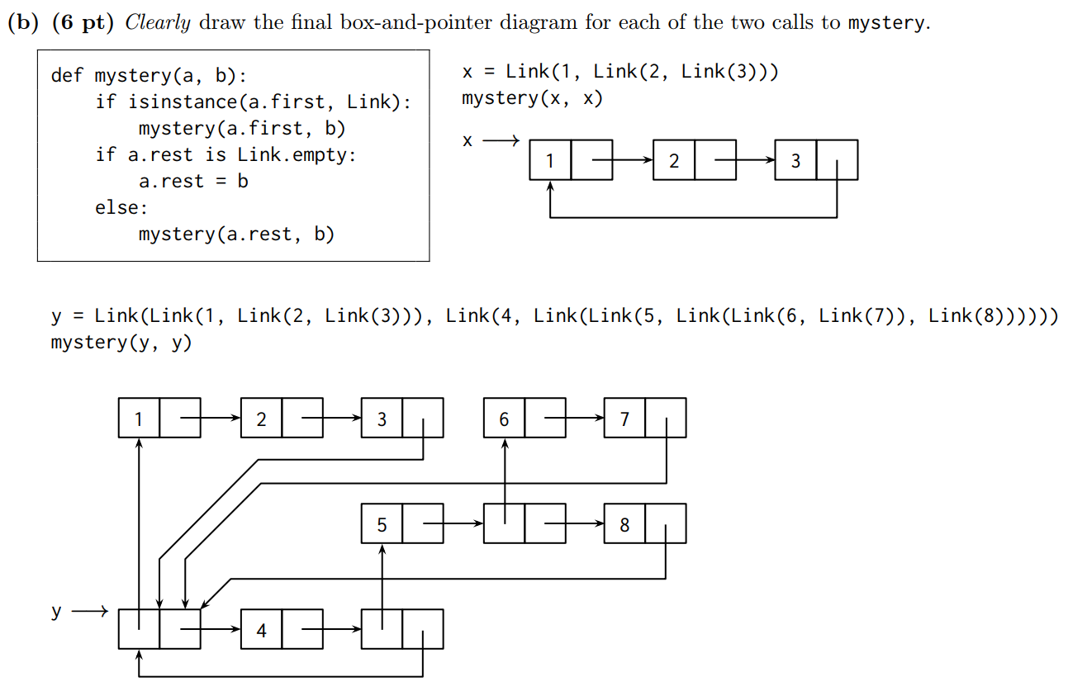
Question 3 Soln (Summer 2017 Final Q2)
Notes:
Hints: First figure out what the function is doing and then apply it to the linked lists.

Slide 33
More Practice with Linked Lists
Spring 2016 Q2 part b
Katya’s Linked List worksheet
See other Topical Review slides on Linked Lists
See the Linked List category in the resources tab on the 61A website
Notes:
Hints: First figure out what the function is doing and then apply it to the linked lists.

Slide 34
Good Luck on the Final!

